Slide 1



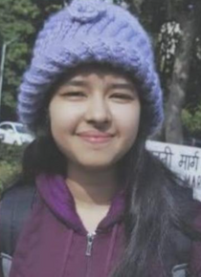

Sis Code Clan
HEAL YOURSELF!
We are listening!
Team Members:
Nandika Arora
Ayushee Agarwal
Riya Bansal
Shagun Uppal

Slide 2
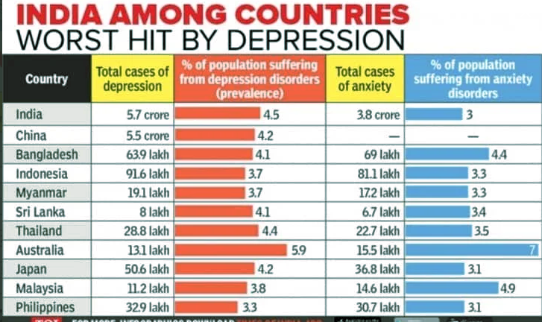
THEME
and
INDIA ranks 139 in World Happiness Report!
PROBLEM
The Theme chosen is "HealthCare and Social Good"
ACCORDING TO STUDY,43% INDIANS SUFFER FROM DEPRESSION .THE AVERAGE SUICIDE RATE IN INDIA IS 10.9 FOR EVERY LAKH PEOPLE AND THE MAJORITY OF PEOPLE WHO COMMIT SUICIDE ARE BELOW 44 YEARS OF AGE.

Slide 3
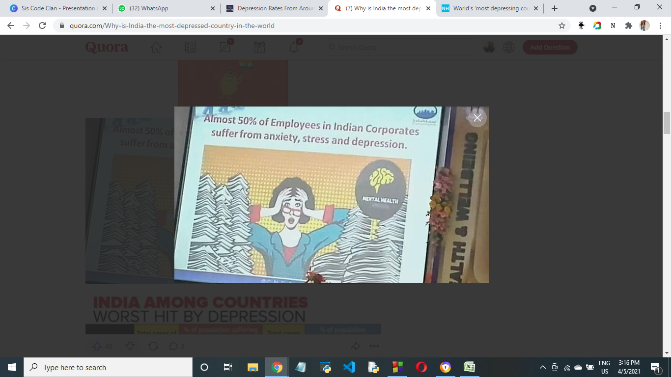
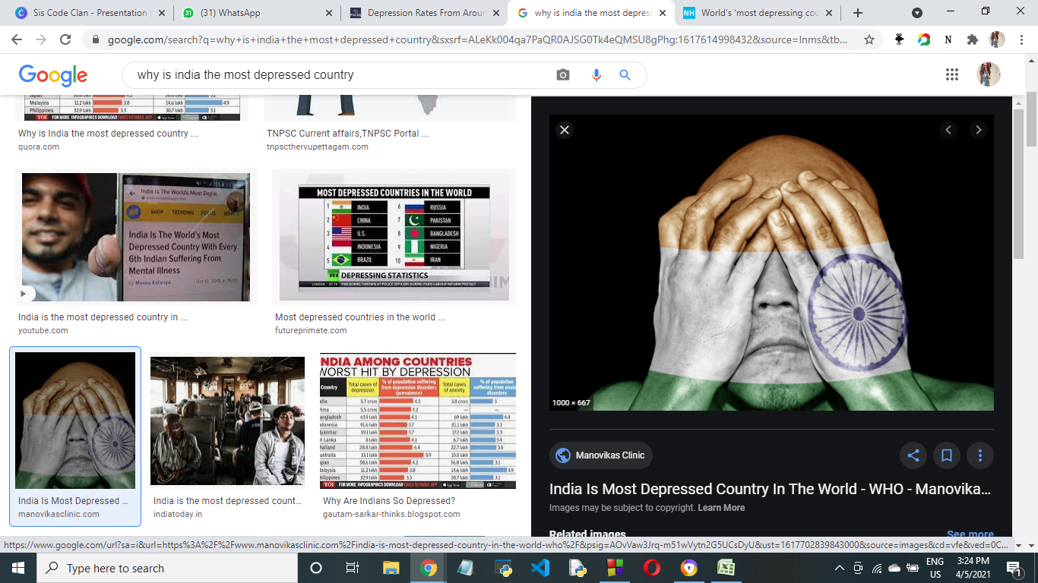
Many a times, we are not able to share our problems, fears with our parents , friends or anyone, And we keep several things inside our mind and think a lot about it which affects our Mental Health!
Depression is still a social stigma in the Indian society.
We are more concerned about “what people will think?”.
It is a very common ailment these days and yet people fail to realize the intensity of it.
Depression leads to loss of identity!
So to overcome or avoid this, we just need someone to listen to us and give us valuable advice!!

Slide 4
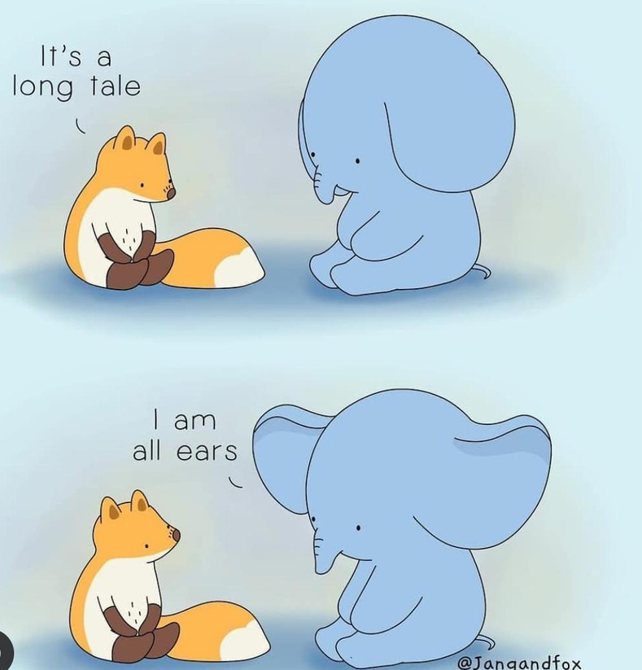
Solution
Heal Yourself is an online emotional support platform providing a group of qualified psychologists.
No matter who you are or where you live or what you’re going through, we will be here to listen to you and care for you.
We might be strangers on the surface, but underneath we're just the friends you haven't met yet.

Slide 5
roadmap
home
about us
QUIZ
Blogs
why us?
Our Events
brief about our psychologists!
Personalized Programs
Emotional abuse? Breaking Trauma Bond? Being Bullied? Feeling Stressed? Want to open up about anything??
Chat with
us!

Slide 6

BEFORE PROCEEDING INTO CHAT , YOU WILL FIRST BE REQUIRED TO GIVE THE DEPRESSION QUIZ.
AFTER THE QUIZ, YOU WILL GET TO KNOW THE RESULTS THAT WHETHER YOU HAVE:
MILD DEPRESSION
SEVERE DEPRESSION
SADNESS
NORMAL

Slide 7

After the quiz, you can go to chat with us and then you will be assigned the Psychologist according to your Result!
NOW you will get in touch with your assigned psychologist who will listen you and guide you!
You can chat anything and dont worry! your chats with psycologist will be secured and will be secured with us!

Slide 8

We have also added:
an event session which will show the upcoming events by great psychologists related to mental health so that you can register and attend!
We are also adding Personalised development programs that are crafted from the years of experience in counselling that our experts bring in.
A Blog/ Researched Content which will show the solution of various Mental Health Related Problems .

Slide 9
HOW IS OUR WEBSITE DIFFERENT FROM OTHERS????
Along with FREE counselling session which is 24 X 7 available and you can chat anonymously, we have added Depression Quiz which will detect if you have mild depression, severe depression , saddness or normal.
We have also added the upcoming Mental health Related Events and Pesonalized Development Course by our Counselling Expert .
We are also adding a group chatapp, in which anyone can enter and chat with each other anonymously. This will overcome your loneliness. [though due to less time contraints we were not able to add this]
EVERYTHING ALONG WITH BLOGS IS ALL IN ONE WEBSITE!!

Slide 10






TECH STACK
HTML CSS Javascript
Bootstrap Nodejs
Socket.io Express

Slide 11
FUTURE SCOPE
For data security, we are planning to add "CRYPTOGRAPHY" Hashmap Algorithm.
Since our main purpose is to keep the identity confedential, we will be using this for storing the message without revealing the identity and its chats as well.
We are also preparing different rooms for different users.
Incase the psychologist is not available and talking to any other client,the client will have to wait for the psychologist to enter the room.

